Slide 1
Python Training
Intermediate

Slide 2



Contents
Data Cleaning
Descriptive Statistics
Data Aggregation

Slide 3
Pandas
Handling missing values
Group By
Apply/transform
Merge/concat
Aggregation
Cleaning data
Descriptive Statistics
Reading data in pandas
Handling it
Exploring it
Performing operations on it

Slide 4
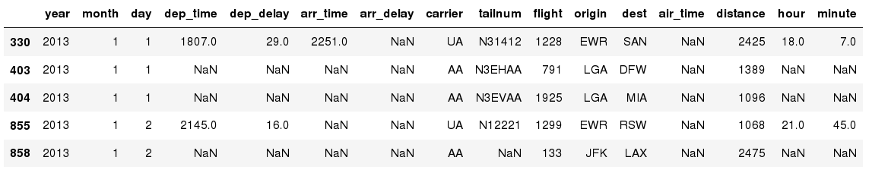
Missing Values
Missing values are marked as NaN⁷
In [ ]:
# Read a dataset with missing values
flights = pd.read_csv("http://rcs.bu.edu/examples/python/data_analysis/flights.csv")
In [ ]:
# Select the rows that have at least one missing value
flights[flights.isnull().any(axis=1)].head()
Out[ ]:

Slide 5
Missing Values
There are several methods to deal with missing values⁸ in the data frame:
df.method() | description
dropna() | Drop missing observations
dropna(how='all') | Drop observations where all cells is NA
dropna(axis=1, how='all') | Drop column if all the values are missing
dropna(thresh = 5) | Drop rows that contain less than 5 non-missing values
fillna(0) | Replace missing values with zeros
isnull() | returns True if the value is missing
notnull() | Returns True for non-missing values

Slide 6
Missing Values
When summing the data, missing values will be treated as zero
If all values are missing, the sum will be equal to NaN
cumsum() and cumprod() methods ignore missing values but preserve them in the resulting arrays
Missing values in GroupBy method are excluded (just like in R)
Many descriptive statistics methods have skipna option to control if missing data should be excluded . This value is set to True by default (unlike R)

Slide 7
Data Cleaning
Removing duplicates
# Check for duplicates
DataFrame_name.duplicated()
In [ ]:
In [ ]:
# Select the rows that have at least one missing value
DataFrame_name.drop_duplicates(subset=None, keep='first', inplace=False, ignore_index=False)
Param:
keep: {‘first’, ‘last’, False}, default ‘first’
Determines which duplicates (if any) to keep. - first : Drop duplicates except for the first occurrence. - last : Drop duplicates except for the last occurrence. - False : Drop all duplicates.
inplace: {bool}, default False
Whether to drop duplicates in place or to return a copy.

Slide 8
Data Cleaning
Formatting data
In [ ]:
# sometimes the date columns have Dates stored in string format. Convert all date columns to ‘DateTime’ datatype
df['Date'] = pd.to_datetime(df['Date'])
Checking for outliers
In [ ]:
# Consider a workout data having attributes such as [Duration, Date, Pulse, Calories]. Let’s say all rows have duration between 30 to 60 but you find one row having value 450. This value is an outlier, and, in this scenario, it can be concluded that work out session cannot be for 450 minutes
#Options to check outlier: create a box plot
fig = px.box(df, y=”Duration”)
fig.show()
# Handling outlier: 1. Replace outlier
df.loc[7, 'Duration'] = 45
# 2. Check fir values greater than threshold and replace them
for x in df.index:
if df.loc[x, "Duration"] > 120:
df.loc[x, "Duration"] = 120

Slide 9
Basic Descriptive Statistics
df.method() | description
describe | Basic statistics (count, mean, std, min, quantiles, max)
min, max | Minimum and maximum values
mean, median, mode | Arithmetic average, median and mode
var, std | Variance and standard deviation
sem | Standard error of mean
skew | Sample skewness
kurt | kurtosis

Slide 10
Descriptive Statistics
Numeric data
In [ ]:
# numeric data
df.describe()
# Result Shows:
count ,mean ,std ,min ,max , inter quartile range
Categorical data
In [ ]:
# Categorical data
df.describe(include:'category’)
# Result shows:
count , unique , top , freq

Slide 11
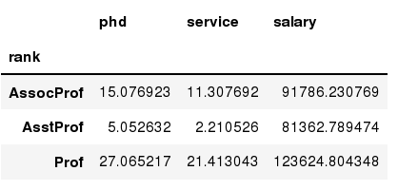
Data Frames groupby method
Using "group by" method we can:
  Split the data into groups based on some criteria
  Calculate statistics (or apply a function) to each group
  Similar to dplyr() function in R
In [ ]:
#Group data using rank
df_rank = df.groupby(['rank'])
In [ ]:
#Calculate mean value for each numeric column per each group
df_rank.mean()

Slide 12
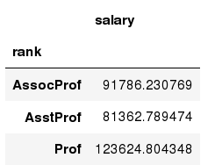
Data Frames groupby method
Once groupby object is create we can calculate various statistics for each group:
In [ ]:
#Calculate mean salary for each professor rank:
df.groupby('rank')[['salary']].mean()
Note: If single brackets are used to specify the column (e.g. salary), then the output is Pandas Series object. When double brackets are used the output is a Data Frame

Slide 13
Data Frames groupby method
groupby performance notes:
  - no grouping/splitting occurs until it's needed. Creating the groupby object only verifies that you have passed a valid mapping
  - by default the group keys are sorted during the groupby operation. You may want to pass sort=False for potential speedup:
In [ ]:
#Calculate mean salary for each professor rank:
df.groupby(['rank'], sort=False)[['salary']].mean()

Slide 14
Apply
pandas.DataFrame.apply
  DataFrame.apply(func, axis=0, raw=False, result_type=None, args=(), **kwargs) [source]
  Apply a function along an axis of the DataFrame.
  Objects passed to the function are Series objects whose index is either the DataFrame’s index (axis=0) or the DataFrame’s columns (axis=1).
  By default (result_type=None), the final return type is inferred from the return type of the applied function. Otherwise, it depends on the result_type argument⁹.
  Returns
    Series or DataFrame
    Result of applying func along the given axis of the DataFrame.

Slide 15
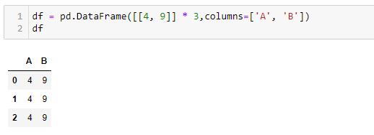
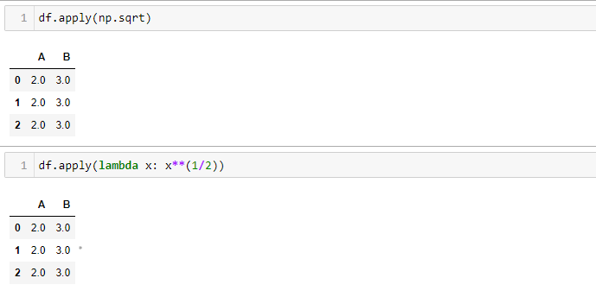
Apply

Slide 16
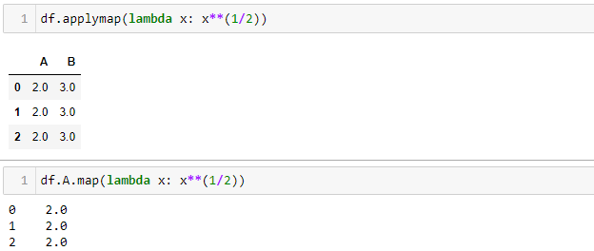
Applymap/map
pandas.DataFrame.applymap
  DataFrame.applymap(func, na_action=None, **kwargs) [source]
  Apply a function to a Dataframe elementwise.
  This method applies a function that accepts and returns a scalar to every element of a DataFrame.
pandas.Series.map
  Series.map(arg, na_action=None) [source]
  Map values of Series according to input correspondence.
  Used for substituting each value in a Series with another value, that may be derived from a function, a dict or a Series.

Slide 17
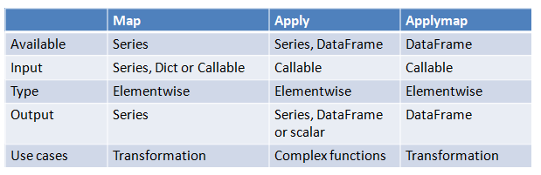
Map/Apply/Applymap

Slide 18
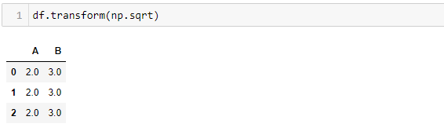
Transform
pandas.DataFrame.transform
  DataFrame.transform(func, axis=0, *args, **kwargs) [source]
  Call func on self producing a DataFrame with transformed values.
  Produced DataFrame will have same axis length as self.
transform | apply
Works with function, string func, list of functions and a dict | Works only with function
Cannot produce aggregated results | Can produce aggregated results
Works with only 1 series at a time | Works with multiple series at a time

Slide 19
Merge/concat
pandas.merge
  pandas.merge(left, right, how='inner', on=None, left_on=None, right_on=None, left_index=False, right_index=False, sort=False, suffixes=('_x', '_y'), copy=True, indicator=False, validate=None) [source]
  Merge DataFrame or named Series objects with a database-style join.
  A named Series object is treated as a DataFrame with a single named column.
  The join is done on columns or indexes. If joining columns on columns, the DataFrame indexes will be ignored. Otherwise if joining indexes on indexes or indexes on a column or columns, the index will be passed on.
  When performing a cross merge, no column specifications to merge on are allowed.
pandas.concat
  pandas.concat(objs, axis=0, join='outer', ignore_index=False, keys=None, levels=None, names=None, verify_integrity=False, sort=False, copy=True) [source]
  Concatenate pandas objects along a particular axis with optional set logic along the other axes.
  Can also add a layer of hierarchical indexing on the concatenation axis, which may be useful if the labels are the same (or overlapping) on the passed axis number.

Slide 20
Aggregation Functions in Pandas
Aggregation - computing a summary statistic about each group, i.e.
  compute group sums or means
  compute group sizes/counts
Common aggregation functions:
  min, max
  count, sum, prod
  mean, median, mode, mad
  std, var

Slide 21
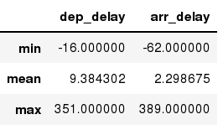
Aggregation Functions in Pandas
agg() method are useful when multiple statistics are computed per column:
In [ ]:
flights[['dep_delay','arr_delay']].agg(['min','mean','max'])
Out[ ]:

Slide 22
Reference
https://docs.python.org/3/tutorial/index.html
https://www.w3schools.com/python/
https://pandas.pydata.org/docs/user_guide/10min.html?highlight=lambda
https://pandas.pydata.org/docs/

